Slide 1
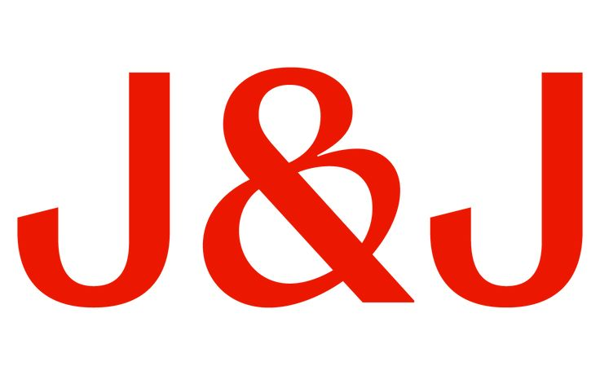
Aegis & Aegis Portfolio Optimization: Strategies for Future Growth
GROUP 4
Lizbeth Gutierrez, Maya Ljapo, Sarayu Mandavilli,
Meghna Parija, Venya Raghavan, Riddhi Sharma

Slide 2
Decision Points

Slide 3
R & D
Reasons for choice:
Symmetric sutures are already patented by competitor so we need IP to enter the popular market
Reasons for not choosing other options:
We did not choose internal because we are not the first to enter the product market
Symmetric: IP
02
Reasons for choice:
We chose to produce it internally so we can enter the new market fast instead of relying on another company.
Reasons for not choosing other options:
IP would slow us down and reduce control
Spiral: Internal
Pricing Strategy
Reasons for choice:
Fund operations while staying affordable to most customers and maintaining strong profit potential→80% of consumers can afford
Reasons for not choosing other options:
Higher prices may increase revenue, but they can reduce profits by driving customers to competitors and costing us market share.
Medium
Marketing
Reasons for choice:
Stronger marketing is required for spiral since it’s a newer market and customers need convincing for entry
Reasons for not choosing other options:
We chose Gold over Bronze or Silver to focus on spiral sutures, as strong marketing is needed to build awareness in this new market
Gold

Slide 4
Reasons for choice:
more cost efficient and allow us to enter the market easier and faster
Reasons for not choosing other options:
more time-consuming and costly, slowing down market entry
Supply Chain
Outsource
Human Capital
Reasons for choice:
most production is outsourced, requiring only essential staff for daily operations
Reasons for not choosing other options:
outsourcing covers most work, and extra staff would unnecessarily raise labor costs
Base

Slide 5
Supply Chain Strategies: Outsourcing
WHY?
Fast lead time→ quick market entry
Increase flexibility
Produce the sutures at a lower cost
  Decrease the amount of investment on manufacturing capacity
  Suppliers can achieve economies of scale
HOW?
Spiral sutures: outsource raw materials
Symmetric sutures: outsource standard production
Maintain relationship with suppliers
  Multi supplier strategy

Slide 6
Human Capital: BASE
WHY?
We do not need specialized workers because most production will be outsourced
Can perform multiple operational tasks
Cost efficient compared to contracting/full time
Easier to adjust with changes in demand
HOW?
Provide basic training for operations
Assign routine tasks that help benefit the outsourcing initiative

Slide 7
SWOT/Risk Analysis

Slide 8
Strengths
#1 position in non-barbed suture market
128K+ employees & global reach (250+ operating companies)
Existing plant in Cornelia, GA
Strong hospital relationships & trusted brand (since 1886)
$67.2B in revenue
Deep MedTech R&D infrastructure
Credo-driven culture builds trust
Weaknesses
No barbed suture product yet
Late to a shifting market
Existing plant at full capacity
Long build times (3-5 yrs) for new plant
Regulatory approval is costly & slow
High fixed operating costs
Building spiral suture IP from scratch requires R&D investment & time
Surgical staples/adhesives compete with sutures broadly

Slide 9
Threats
Crius (Poseidon) already FDA-approved with dual-angle barbed suture
Athena (Kronos) has 2005 patent & established symmetrical design
Competitors are developing spiral sutures window is closing
Alternative closure: tissue adhesives, staples, negative pressure therapy
Pricing pressure from hospitals & insurance payers
Raw material cost volatility
Opportunities
Robotic surgery boom driving barbed suture demand
Spiral suture relatively new to market
  First-mover advantage available
Aging global population = more surgeries
Emerging markets expanding access
Minimally invasive surgery trend
Barbed sutures cut OR time & infection risk
Competitors are smaller (Athena: $221M revenue)

Slide 10
01
Competitor Dominance:
  Purchase Intellectual Property now for instant market entry
Slow Time-to-Market
  Outsource manufacturing to generate revenue immediately
Highest Risk
02
FDA Regulatory Delays
  Purchase IP with existing FDA clearance
Supply Chain Risk
  Negotiate strict Quality Control contracts with outsource partner.
  Hire full-time employees if building in-house for long-term culture
High Risk
03
Pricing Pressure
  Choose medium pricing to balance margin and access
  Use Gold marketing to justify premium via clinical outcomes
Moderate Risk
04
Alternative Wound Closure Products
  Emphasize barbed suture's unique benefits (knotless, watertight) vs. alternatives.
  Track market shifts annually.
IP Failure / Infringement
  Conduct patent landscape review before R&D begins.
Low Risk

Slide 11
Competitive Analysis

Slide 12
Traditional Sutures
Smooth threads that require knots
Barbed Sutures
Knotless sutures with tiny barbs

Slide 13
Competitive Advantage
Ease of use
Helpful in minimally invasive surgeries
Better performance
Competitive edge
Limitations
May lead to complications
Cost disadvantage → more expensive
Lack of universality
Difficult to reverse or adjust

Slide 14
01
Competitive in spiral sutures
Early FDA approval
Advanced design that differentiates
Large scale global presence
Already positioned in the market
Crius (Poseidon)
02
Patent-protected technology in symmetrical sutures
Has high specialization
Competes on product differentiation and niche expertise
Focuses on affordability and usability
Already established in the core product A&A wants to enter
Athena (Kronos)
03
Faster application
Widely used in high-volume procedures
Easy to use
Reduced training requirements
Surgical Staples
04
Non-invasive
Reduced scarring and infection risk in some cases
Reduces total demand for sutures
Especially impactful in routine or low-complexity procedures
Tissue Adhesives

Slide 15
A&A Competitive Advantages
Brand trust advantage
  Known for high-quality, reliable products
  Critical in healthcare, where risk tolerance is low
  Surgeons prefer trusted suppliers over unknown innovators
Distribution and Scale
  Existing relationships with hospitals, surgical centers, and a global logistics network
  Enables faster adoption once the products are launched
Financial Strength
  Large revenue base
  Ability to invest in R&D, acquire IP, and cover regulatory costs

Slide 16
A&A Competitive Disadvantages
Late entry into barbed sutures
  Competitors already have FDA approval, are market-tested, and surgeon approved
Switching costs and surgeon habits
  Surgeons are already trained on specific techniques and familiar products
  Will face resistance to a new product
Regulatory barriers
  High cost and time to approval
Pricing pressure
  Market already includes high-cost innovative products and more affordable specialty products

Slide 17
01
Purchase IP
Enter market quickly
Compete on brand, distribution, and pricing
Fast Follower (low risk)
02
Develop spiral sutures internally
Be first to market
Gain market leadership, premium pricing, and long-term market dominance
Innovative Leader (high risk)
03
Purchase symmetrical sutures IP
Develop spiral sutures internally
Balances immediate competitiveness with future differentiation
Hybrid Strategy (most competitive)

Slide 18
Sensitivity Analysis

Slide 19
Portfolio Insight
The sensitivity analysis is meant to test the strength of our decision points
We focused on three key drivers: marketing, pricing, and market share
Overall Goal: understanding how these three variables affect profitability (Net Present Value)

Slide 20
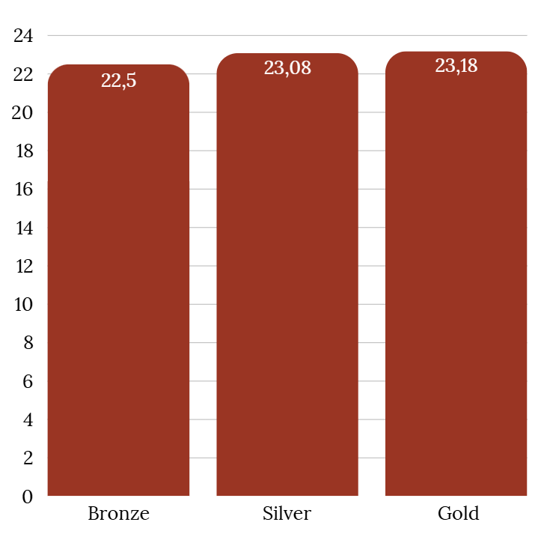
Marketing Sensitivity
Held pricing constant to isolate marketing strategy impact on NPV
As marketing quality increases (Bronze to Gold)... NPV increases, Gold standard marketing being the highest
Spiral sutures are newer to the market:
  Surgeons need in person demonstrations & research to trust product
  Builds awareness & education
Gold-level Marketing:
  Maximizes adoption
  Contributes to the highest NPV
NPV (In Millions)
Marketing Strategy

Slide 21
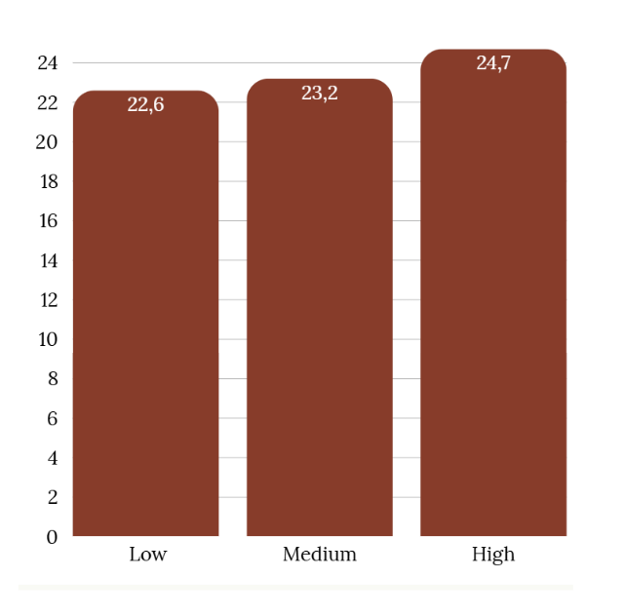
Pricing Sensivity
Held marketing constant at Gold level to isolate pricing strategy effects
As pricing increases:
  NPV rises from $22.6 million to $24.7 million
  Contributes to the highest NPV
Higher pricing means:
  Higher perceived quality and credibility
  Get a better ROI for the development of spiral sutures
Decision - Medium Pricing:
  High pricing = higher profit, but lower accessibility to target consumer
  Affordability increases adoption rate
NPV (In Millions)
Pricing Strategy

Slide 22
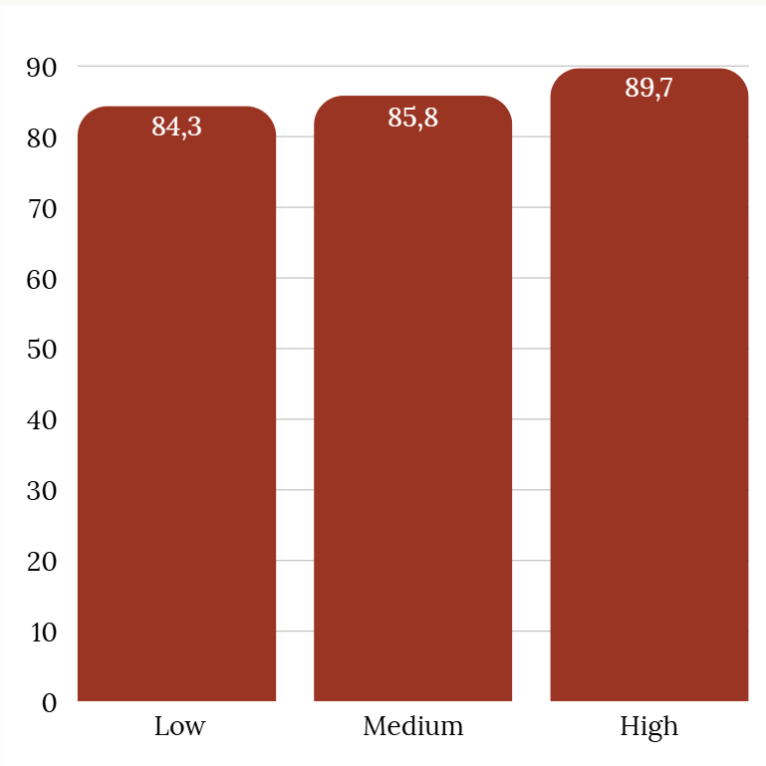
Market Share Sensitivity
Market share = product of Gold standard marketing + different pricing strategies
As pricing increases:
  Market share rises from 84.3% to 89.7%
  Reflecs adoption of both symmetrical and spiral sutures
Going from High - Medium pricing means
  Losing 3.9% market share
Medium pricing Implies:
  Improving accessibility - faster market penetration
  Reducing risk of competitors undercutting price
  Broader customer base for long term growth
Market Share Percentage
Marketing Strategy

Slide 23
Finances

Slide 24
High vs. Medium Price Comparison
High Price | Medium Price
Market Growth: 7.5% Beginning Share: 56.4% Peak Share: 89.7% End Share: 89.7% Net Trade Sales: $119,174,552 Gross Profit: $91,397,691 Net Present Value: $24,688,613 Internal Rate of Return: 0% Payback Period: 0.1051 | Market Growth: 7.5% Beginning Share: 56.4% Peak Share: 85.8% End Share: 85.8% Net Trade Sales: $115,955,944 Gross Profit: $88,179,083 Net Present Value: $23,183,273 Internal Rate of Return: 1% Payback Period: 0.1132
Notes:
NPV > 0 then we should accept!
Medium Price: NTS Yearly average: $10,541,449, Gross Profit Yearly average: $8,016,280
High Price: NTS Yearly average: $10,834,050, Gross Profit Yearly average: $7,901,642

Slide 25
Alignment with Credo
High Price vs Medium Price
Affordable to only 65% of Target Market
Affordable to 80% of Target Market
A&A Credo: “We believe our first responsibility is to the patients, doctors and nurses, to mothers and fathers and all others who use our products and services. In meeting their needs everything we do must be of high quality. We must constantly strive to provide value, reduce our costs and maintain reasonable prices.
Notes:
NPV > 0 then we should accept!
Medium Price: NTS Yearly average: $10,541,449, Gross Profit Yearly average: $8,016,280
High Price: NTS Yearly average: $10,834,050, Gross Profit Yearly average: $7,901,642

Slide 26
Low vs. Medium Price Comparison
Low Price | Medium Price
Market Growth: 7.5% Beginning Share: 56.4% Peak Share: 84.3% End Share: 84.3% Net Trade Sales: $114,694,926 Gross Profit: $86,918,066 Net Present Value: $22,593,082 Internal Rate of Return: 3% Payback Period: 0 | Market Growth: 7.5% Beginning Share:56.4% Peak Share: 85.8% End Share: 85.8% Net Trade Sales: $115,955,944 Gross Profit: $88,179,083 Net Present Value: $23,183,273 Internal Rate of Return: 1% Payback Period: 0.1132
Notes:
NPV > 0 then we should accept!
Low Price: NTS Yearly average: $10,426,811, Gross Profit Yearly average: $7,901,642
Medium Price: NTS Yearly average: $10,541,449, Gross Profit Yearly average: $8,016,280

Slide 27
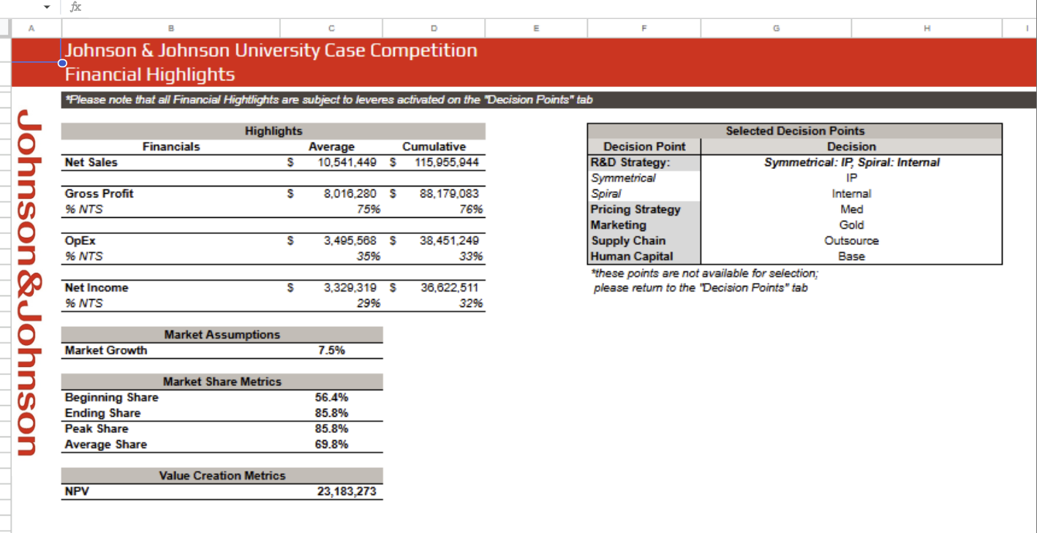

Slide 28
Bronze vs. Silver Marketing
Bronze | Silver
Market Growth: 7.5% Beginning Share: 56.4% Peak Share: 81.1% End Share: 81.1% Net Trade Sales: $112,064,343 Gross Profit: $84,287,482 Net Present Value: $22,564,613 Internal Rate of Return: 1% Payback Period: 0 | Market Growth: 7.5% Beginning Share: 56.4% Peak Share: 84.5% End Share: 84.5% Net Trade Sales: $114,851,738 Gross Profit: $87,074,878 Net Present Value: $23,088,766 Internal Rate of Return: 1% Payback Period: 0
Notes:
NPV > 0 then we should accept!
Bronze Marketing: NTS Yearly Average: $10,187,668, Gross Profit Yearly Average: $7,662,498
Silver Marketing: NTS Yearly Average: $10,441,067, Gross Profit Yearly Average: $7,915,898

Slide 29
Bronze vs. Gold Marketing
Bronze | Gold
Market Growth: 7.5% Beginning Share: 56.4% Peak Share: 81.1% End Share: 81.1% Net Trade Sales: $112,064,343 Gross Profit: $84,287,482 Net Present Value: $22,564,613 Internal Rate of Return: 1% Payback Period: 0 | Market Growth: 7.5% Beginning Share: 56.4% Peak Share: 85.8% End Share: 85.8% Net Trade Sales: $115,955,944 Gross Profit: $88,179,083 Net Present Value: $23,183,273 Internal Rate of Return: 1% Payback Period: 0
Notes:
NPV > 0 then we should accept!
Bronze Marketing: NTS Yearly Average: $10,187,668, Gross Profit Yearly Average: $7,662,498
Gold Marketing: NTS Yearly Average: $10,541,449, Gross Profit Yearly Average: $8,016,280

Slide 30
Silver vs. Gold Marketing
Silver | Gold
Market Growth: 7.5% Beginning Share: 56.4% Peak Share: 84.5% End Share: 84.5% Net Trade Sales: $114,851,738 Gross Profit: $87,074,878 Net Present Value: $23,088,766 Internal Rate of Return: 1% Payback Period: 0 | Market Growth: 7.5% Beginning Share: 56.4% Peak Share: 85.8% End Share: 85.8% Net Trade Sales: $115,955,944 Gross Profit: $88,179,083 Net Present Value: $23,183,273 Internal Rate of Return: 1% Payback Period: 0
Notes:
NPV > 0 then we should accept!
Silver Marketing: NTS Yearly Average: $10,441,067, Gross Profit Yearly Average: $7,915,898
Gold Marketing: NTS Yearly Average: $10,541,449, Gross Profit Yearly Average: $8,016,280

Slide 31
So Why Gold?
Patients First → reaches more & with high quality of care
Value → encourages investment while keeping prices justifiable
Partners → a realistic model that allows partners to thrive with us
Employees → room to invest in talent, development, & strong environment
Communities → expands access to care
Shareholders Last → once all responsibilities met, long-term success

Slide 32
Thank You!

Slide 33
Sources
Surgical Suture Market Report: Trends, Forecast and Competitive Analysis to 2031
First Mover Advantage - Benefits and Drawbacks of Being First
Surgical Sutures Market Size & Growth to 2035
Surgical Sutures Market Size & Growth Forecast to 2030
Negative Pressure Wound Therapy
Global Surgical Sutures Market Size, Trends, Share 2030
Wound Closure Devices Market Size | Industry Report, 2030
Quality Control (QC): What It Is, How It Works, and QC Careers
Global Surgical Sutures Market Size, Trends, Share 2030
Profit Margin: Definition, Types, Uses in Business and Investing
Wound Closure Devices Market Size | Industry Report, 2030

